Slide 1
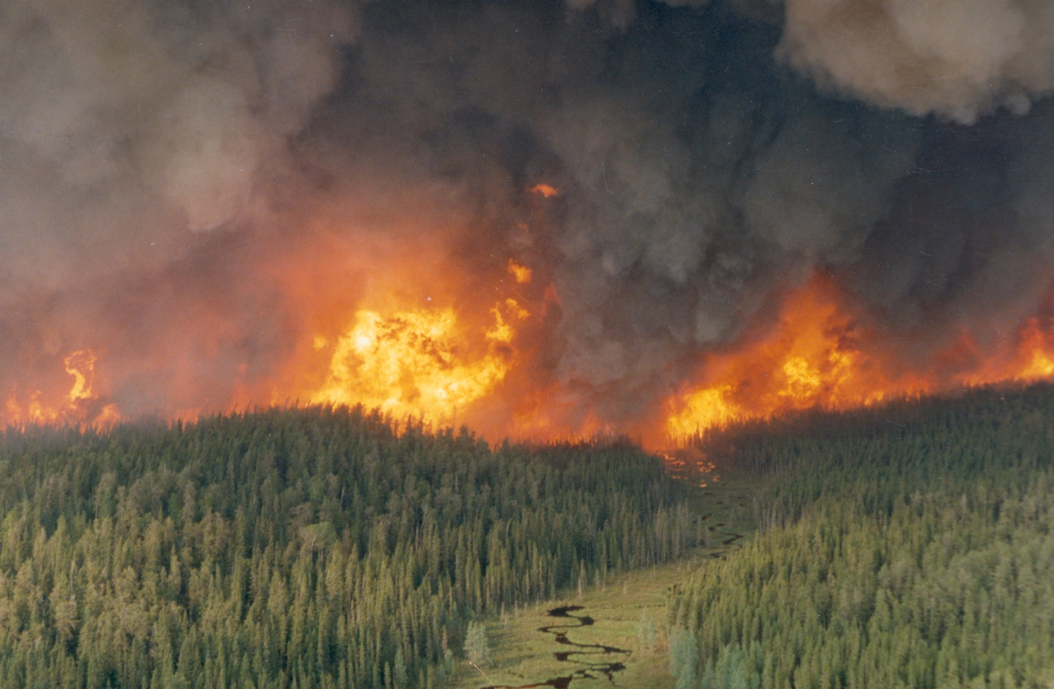
NASA Applied Sciences
Wildland Fire Program:
Potential Use for Suomi-NPP
Amber Soja and Vince Ambrosia
Associate Program Managers
NASA Applied Science Program
Wildland Fire
Lawrence Friedl
Program Manager
amber.j.soja@nasa.gov
vincent.g.ambrosia@nasa.gov
Second S-NPP Application Workshop
Huntsville, Alabama
19 November 2014

Slide 2
Mean seasonal temperature changes 1965 to 2004 .
Temperatures are increasing, particularly in the Northern Hemisphere winter and spring,
which leads to
longer growing seasons,
increased potential evapotranspiration and extreme fire weather.
winter
spring
[Groisman et al., 2007; Jones and Moberg, 2003, updated]
summer

Slide 3

Many authors have argued that the initial signs of climate-related change in fire regimes is currently evident across Northern Hemisphere upper latitudes.
Anatoly Sukhinin – Increase in catastrophic fires in Siberia that sustain high pressure weather systems;
Stocks, Fosberg, Lynham, Mearns, Wotton, et al., (1998) - Canadian GCM predicts an earlier start to the fire season & significant increases in the area experiencing high to extreme fire danger in Can and Russia.
Gillette, Weaver, Zwiers, Flannigan (2004) - Human-induced climate change has had a detectable influence on the area burned by forest fire in Canada over recent decades;
Kasischke, Turetsky (2006) – Doubling of frequency of large fire across boreal NA;
Westerling, Hildalgo, Cayan, Swetnam (2006) – Historic large fires in the western US are largely under the control of weather and climate, not dominantly historic fire suppression.
Soja, Flannigan, Stocks, Chapin, Sukhinin (2007) – Initial signs of climate change are apparent (changes in species composition, increased extreme fire years across the circumboreal).

Slide 4
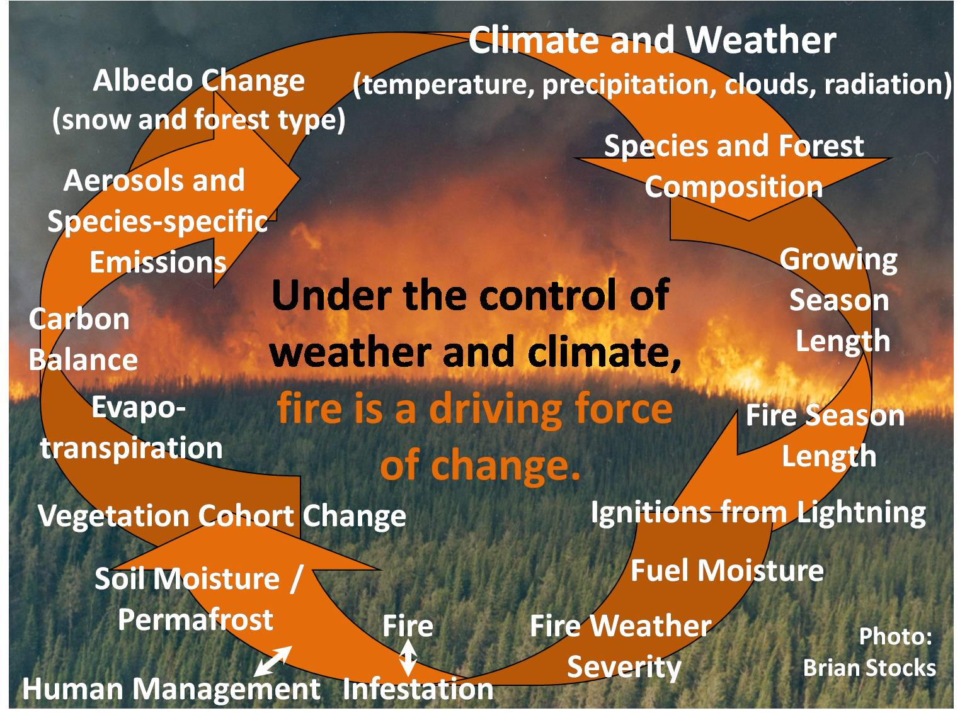
Urban Interface

Slide 5
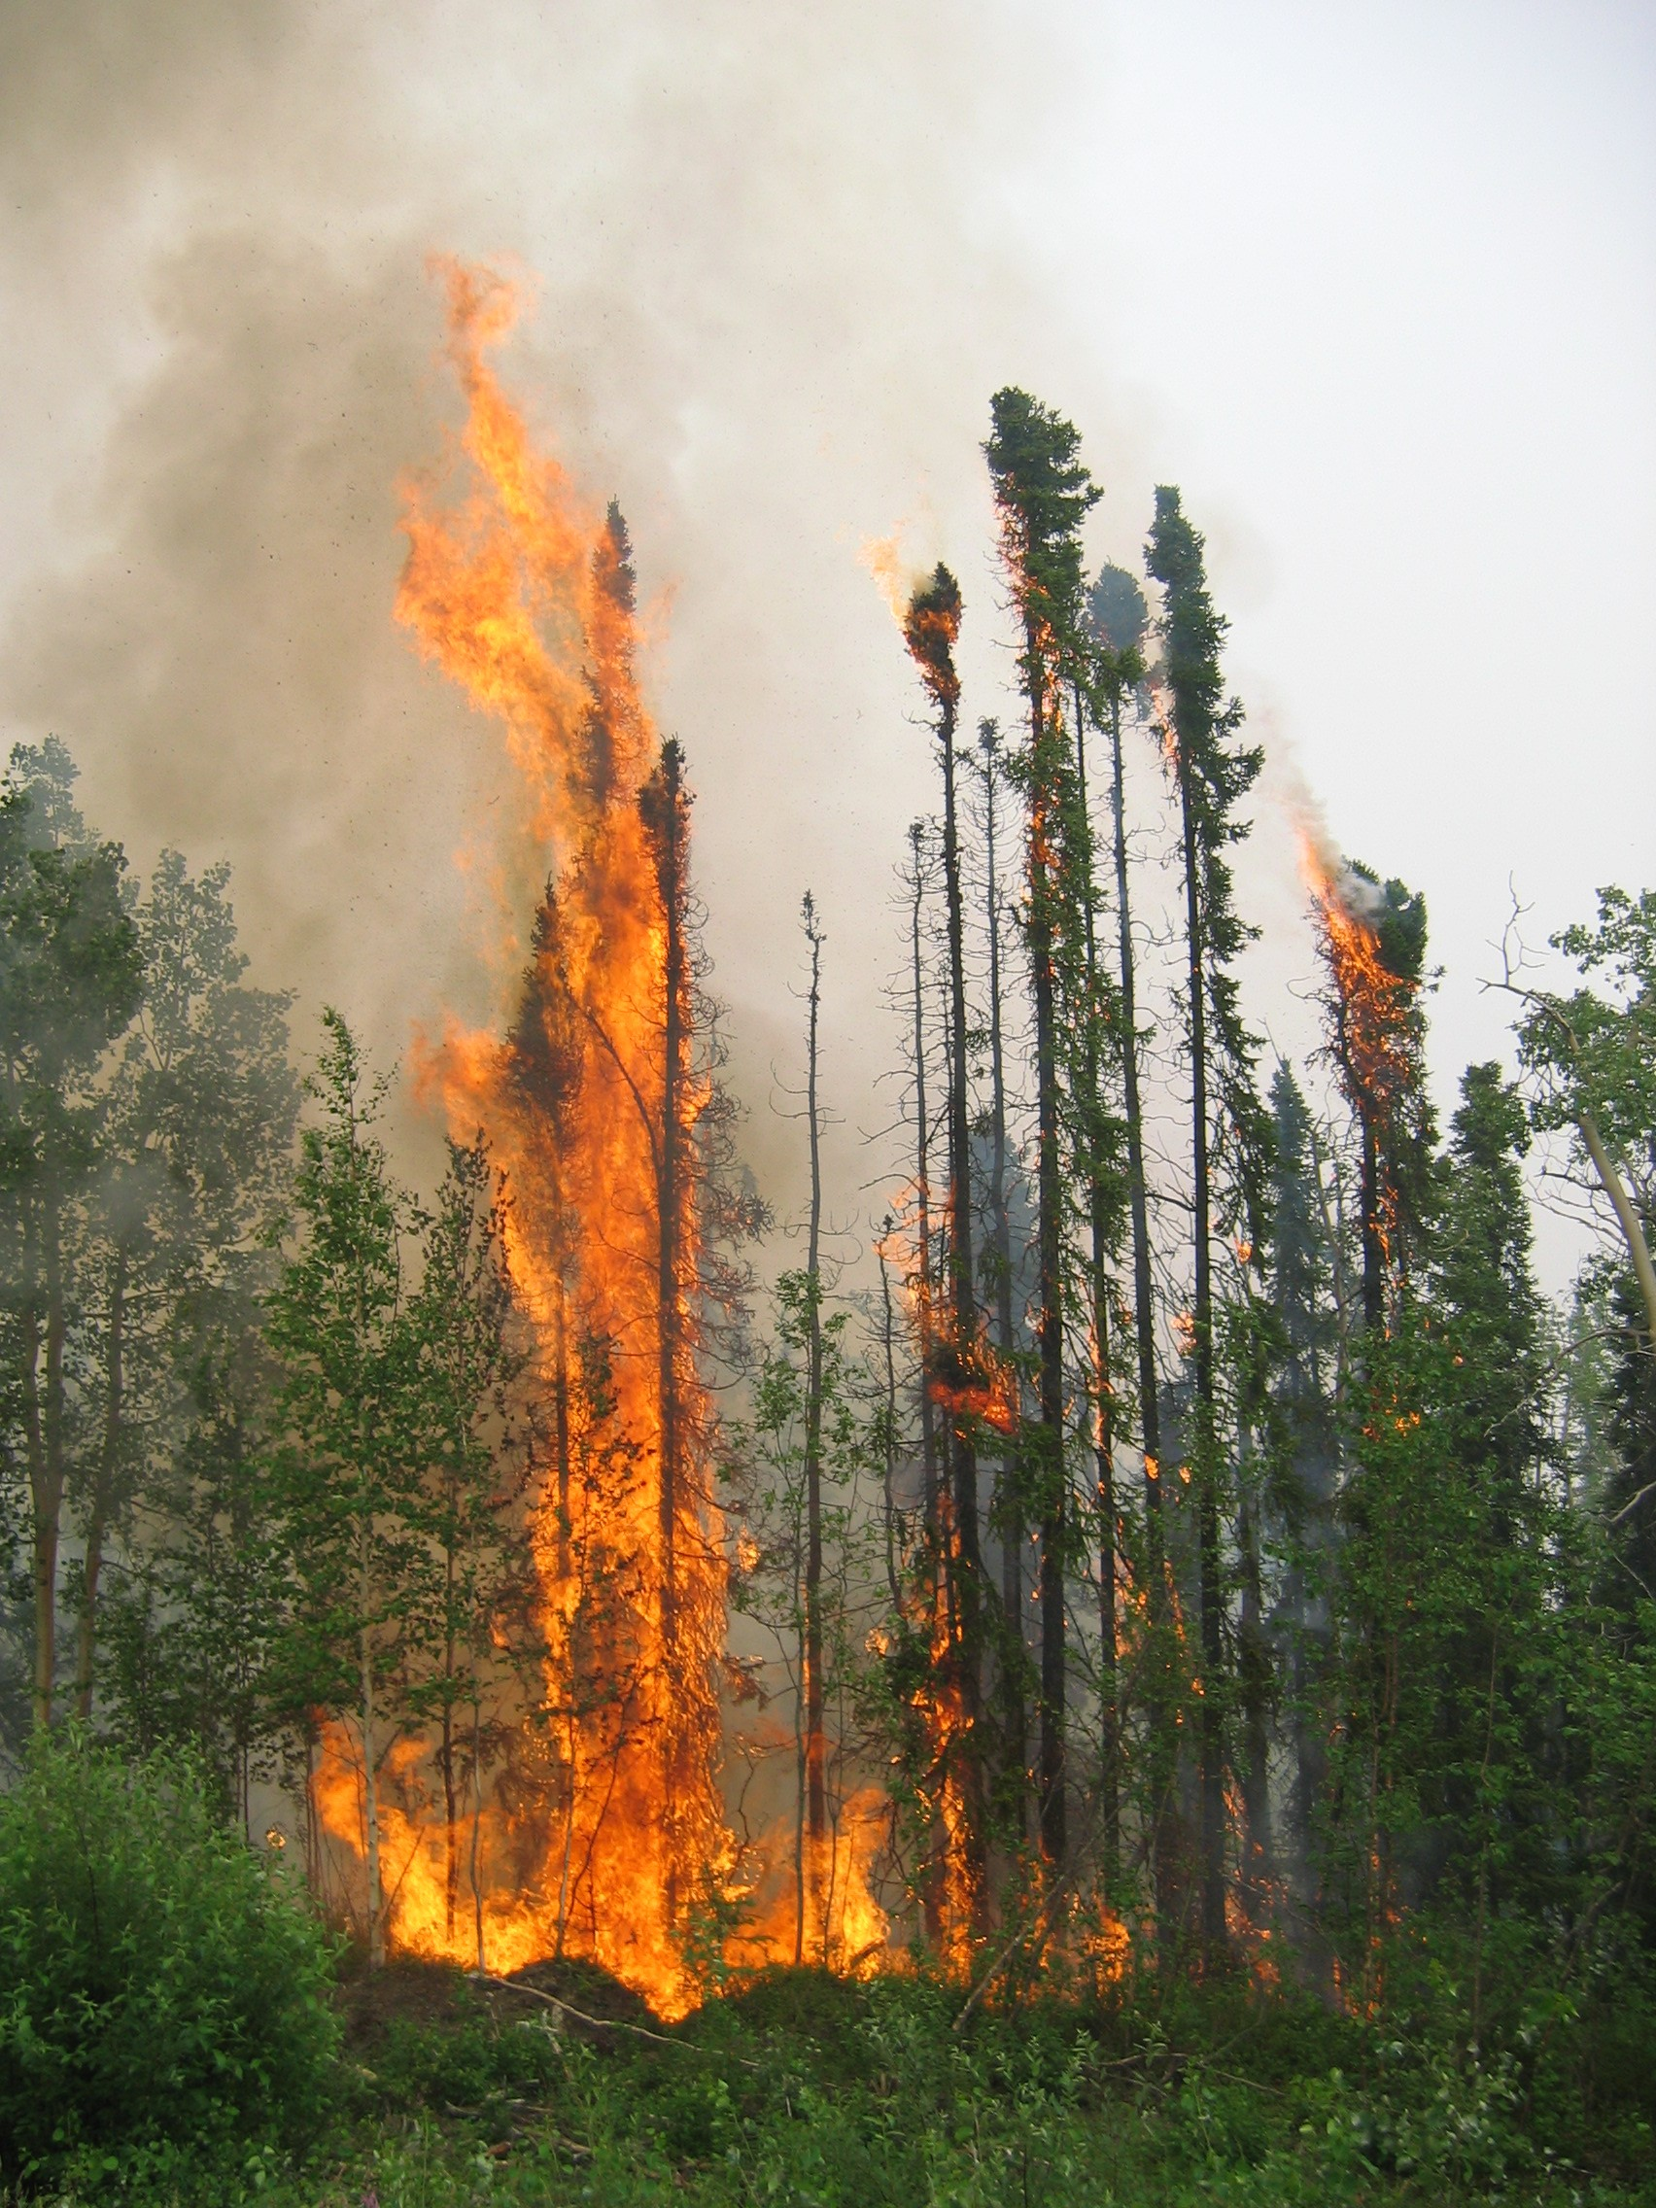
Climate holds the ultimate key to altering ecosystems (temperature and precipitation).
II. Climate has the potential to affect fire regimes by:
(1) altering species composition;
(2) altering fire ignitions from lightening and;
(3) altering weather conditions conducive to fire.
Photo: S. Conard
Soja et al., 2004

Slide 6
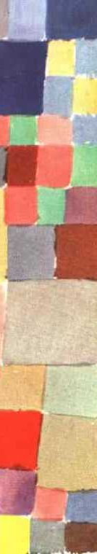
NASA Applied Sciences Program
Vision
Public and private organizations routinely and seamlessly integrate Earth observations in their decisions and actions, and they demand additional observation types and Earth science knowledge.

Slide 7
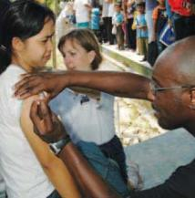
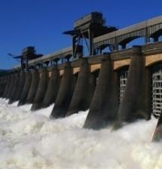
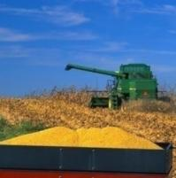
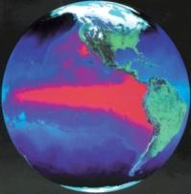
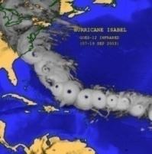
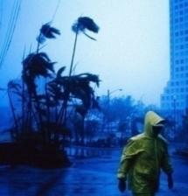

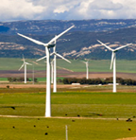

Fires Crosscut Application Areas
Emphasis in
4 Applications Areas
Support opportunities in
5 additional areas
Health &
Air Quality
Agriculture
Climate
Weather
Water Resources
Energy
Oceans
Disasters
Ecological Forecasting
Crosscutting theme:
Wildland Fires
|‌ 7

Slide 8
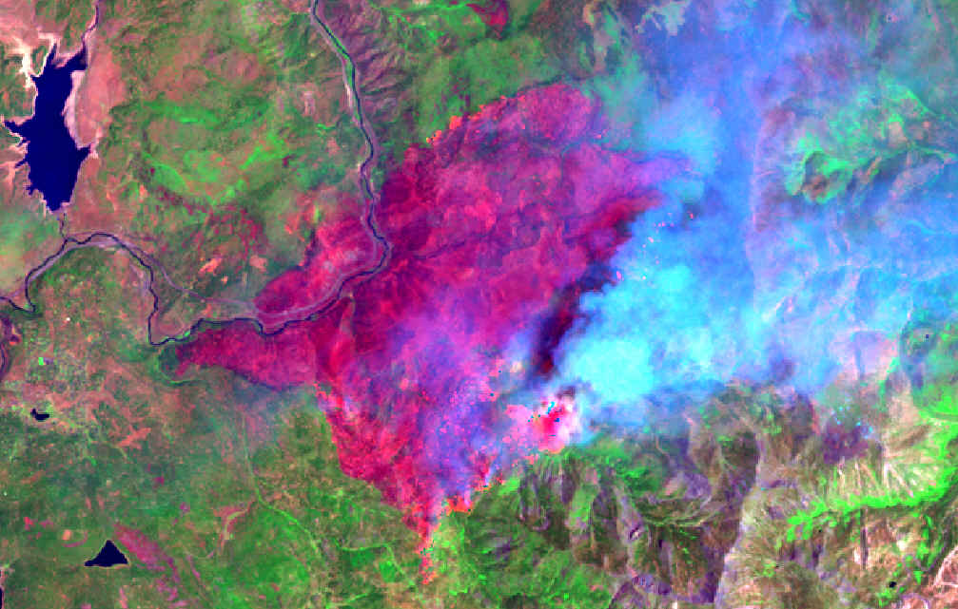
Applied Sciences Program
ROSES
A.35 Wildland Fires
Phase 2 Implementation selections 2014
PHASE 1 FEASIBILITY
DEVELOP A TWO-PHASE APPROACH
Develop baseline, fire-related applications tools, information, models, or technologies;
Early partnership engagement
PHASE 2 IMPLEMENTATION
SOLICITATION OBJECTIVES
Transitioning feasible, beneficial applications to an operational status with the partner organization and/or end users.
Improve decision-making activities and actions on topics related to wildland fires, such as wildfires, rangeland fires, and prescribed fires
(air quality, mitigation, restoration, pre-fire planning and preparation).
Focuses investments on projects with high-reward potential.
Prioritizes partners with commitment to adopting project results.
RESULTS

Slide 9
ROSES-2011 A.35
Key Questions for Evaluation
Is it feasible?
Is it valuable?
Is there commitment?
A successful project needs to be technically achievable, useful, and wanted.
|‌ 9
Notes:
Feasible is not just risk

Slide 10
Two-Stage Approach
Feasibility-to-Decision Support Projects
A two-stage approach to identify more high-reward projects with strong commitment by partner organizations. Start with multiple feasibility studies of possible applications ideas. After a year, the Program selects a subset of successful studies to pursue as in-depth applications projects.
Approach generates numerous applications ideas and focuses investments on those with high-reward potential.
Approach prioritizes partners’ “skin-in-the-game” to increase their involvement in project and commitment to adopting the project results.
|‌ 10
Notes:
Purpose: Identify, prioritize, and implement high-reward applications ideas with committed partners
The Program developed a new, two-stage approach. The Program began using this in ROSES-11 for projects beginning in FY12. New approach is a way to identify more high-reward projects. Initially, the Program will sponsor numerous short-term feasibility studies to test applications ideas and assess their potential value. Then, the Program will select a sub-set of successful studies to pursue in the long-term, with partner funding and commitment as key factors in the selection. This approach can generate numerous applications ideas and focus investments on those with high-reward potential.
These solicitations will initially support feasibility studies of potential applications; NASA will select and continue support of a subset of these applications in subsequent projects to develop and transition the application fully.
Initial awards are one-year in duration (Stage 1-Feasibility Study). Based on an evaluation at the end of year one, the grantee MAY be selected to continue work in years two through four (Stage 2-Decision Support Project). An assessment of Stage 1 results, partner commitment, and in-person presentations will be used to assess Stage 2 award continuations.

Slide 11
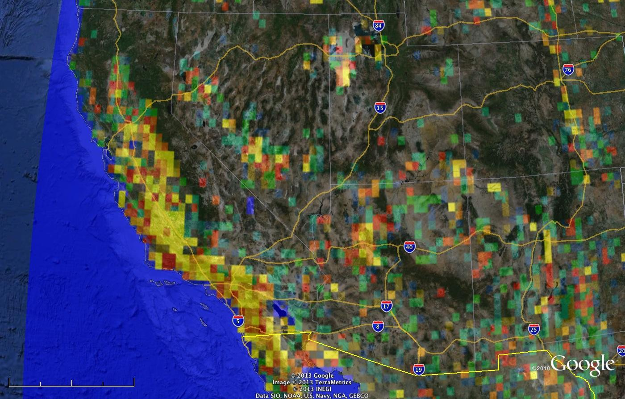
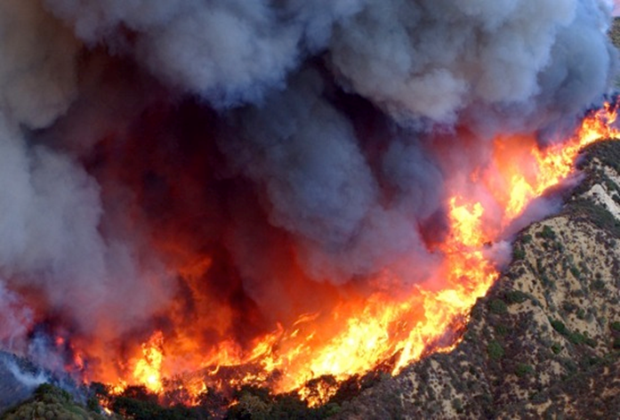
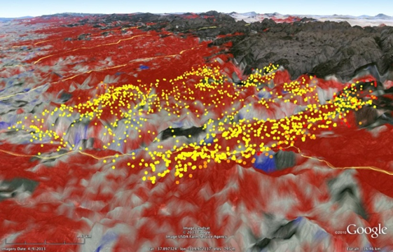
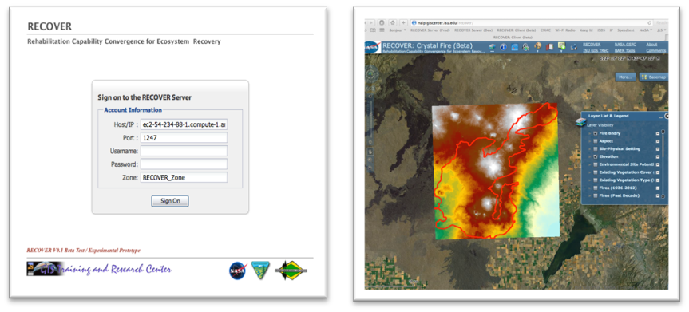
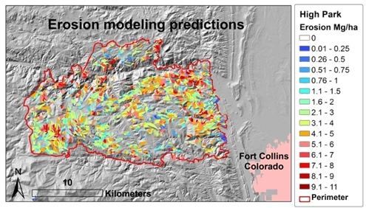
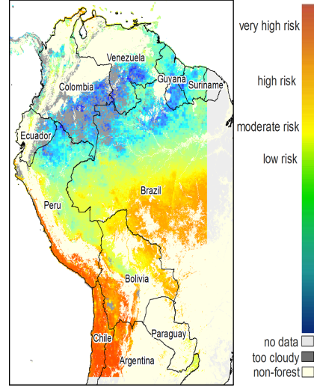
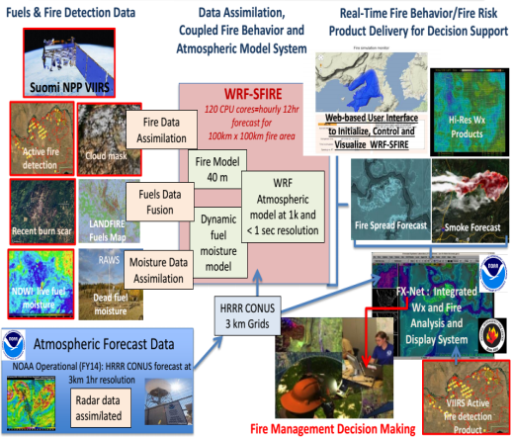
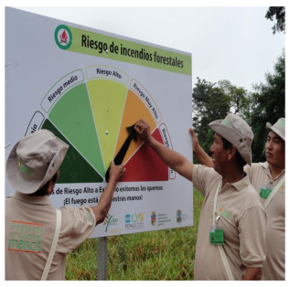
2014 NASA
Applied Sciences Program:
Wildland Fire Applications 17 Projects originally,
9 selected for implementation
R/T Forecast of Rx burning on PM2.5
Soil Moisture Change for Fire Potential
Web-enabled Post-Fire Rehabilitation Planning Application
Fire Behavior and Risk Forecasting
Erosion Model Prediction
International R/T Fire Alerts
Notes:
Examples of original 17 project Phase 1 efforts…NOT all inclusive or representative of those that went forward in Phase II funding.

Slide 12
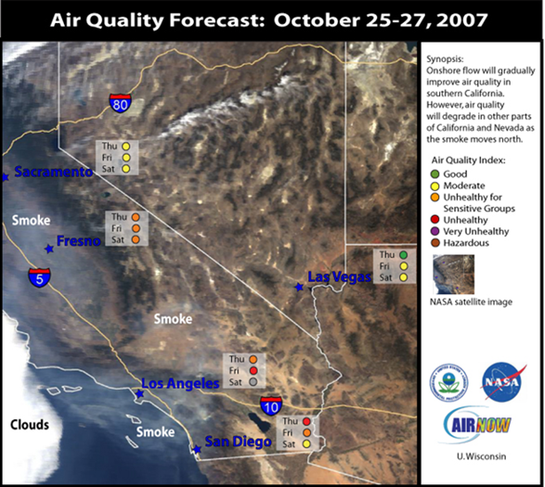
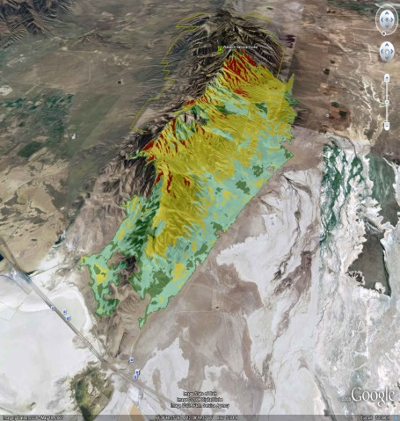
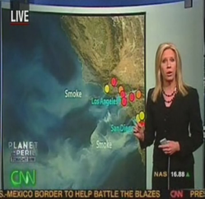
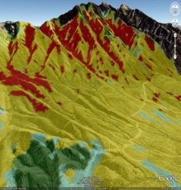
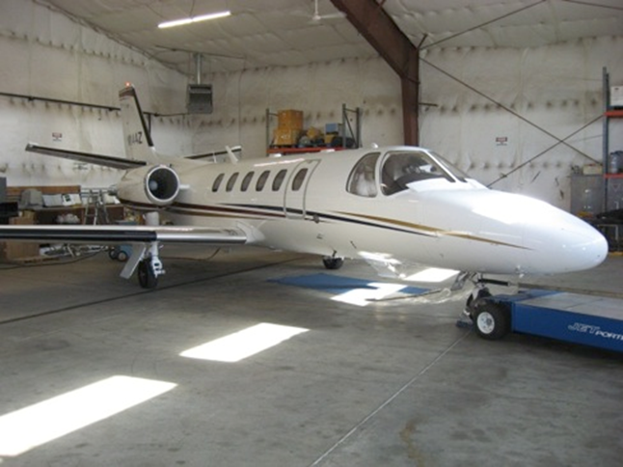
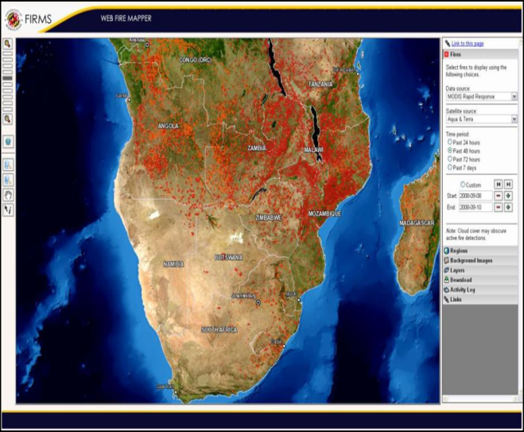
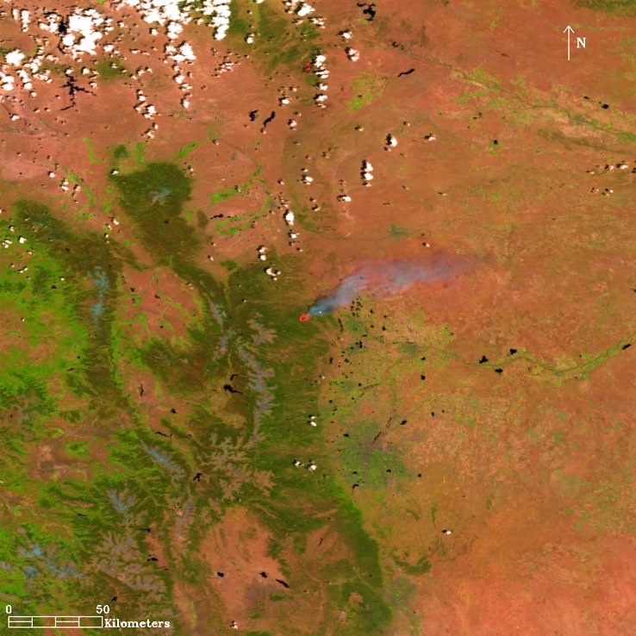
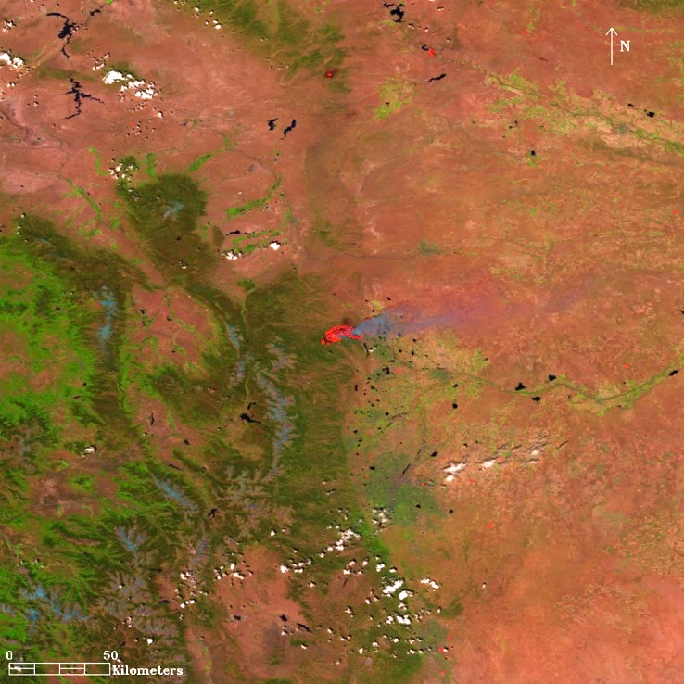
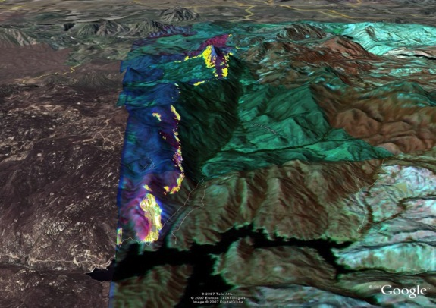
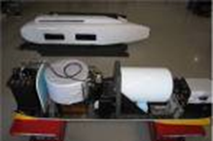
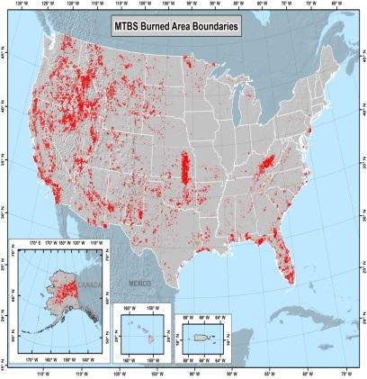
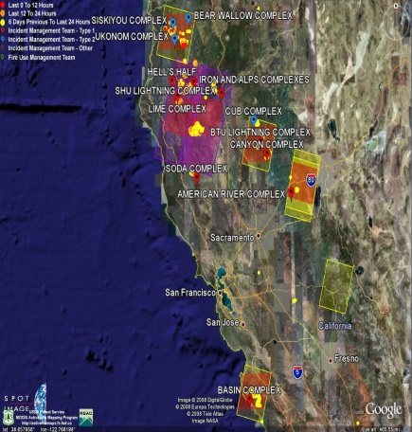
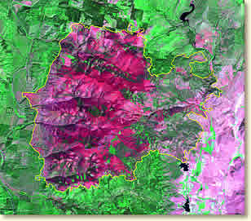
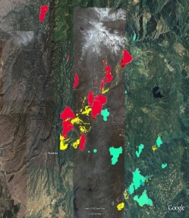
Transitioned NASA Data, Models, Technologies to Operational Fire Management Support
Burned Area Reflectance Classification - Landsat
Satellite Observations Support Air Quality Estimates & Forecast
Fire Detections & Satellite Continuity
Improved Airborne Fire Imaging
MODIS
High Park Fire, Colorado
VIIRS
09 June 2012
10 June 2012
UN FAO Global Fire Information Management System
Collaborative Decision Environment for R/T Fire Monitoring
Supports improved management strategies for mitigation of wildfire effects on ecosystems, infrastructure and human lives.
Monitoring Trends in Burn Severity (MTBS)

Slide 13
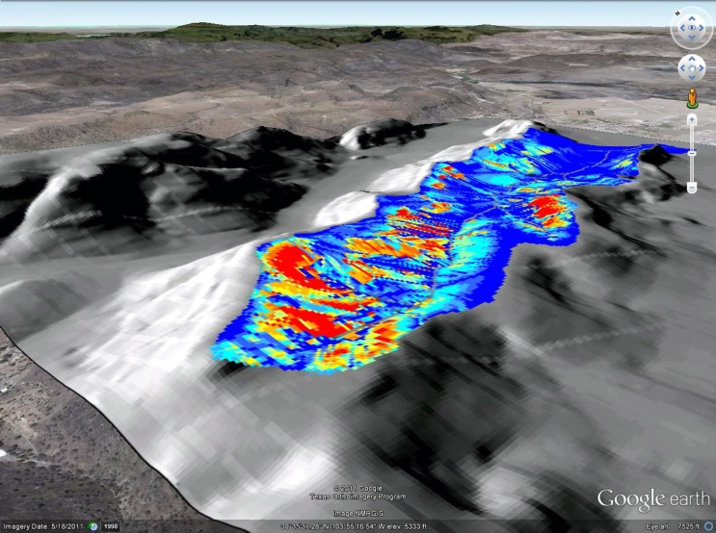
RECOVER Support Wildfire Rehabilitation of Grassland Ecosystems
Weber et al.
BAER Project: Improving Post-Fire Remediation Through Hydrological Modeling
Miller et al.
Support improved management strategies for mitigation of wildfire effects on ecosystems and infrastructure.
Burned Area Emergency Response (BAER)
Erosion predictions for the Rock House Fire converted to KML; Fire Date: April 9, 2011; Location: Fort Davis, TX Size: 314,444 acres; Hospital Canyon: 536 acres; BAER Team: U.S. National Park Service.

Slide 14
FIRECAST: A Near-Real-Time Monitoring System Improving Forest Management in the Tropics
Karyn Tabor et al.
FIRECAST uses satellite data to deliver daily email alerts of fire activity and daily forest flammability alerts that are used to warm communities and authorities of dangerous fire conditions.
Targets areas of high biodiversity and specific communities.
Currently the system operates in Brazil, Peru, Madagascar and Bolivia
Notes:
Examples of original 17 project Phase 1 efforts…NOT all inclusive or representative of those that went forward in Phase II funding.

Slide 15
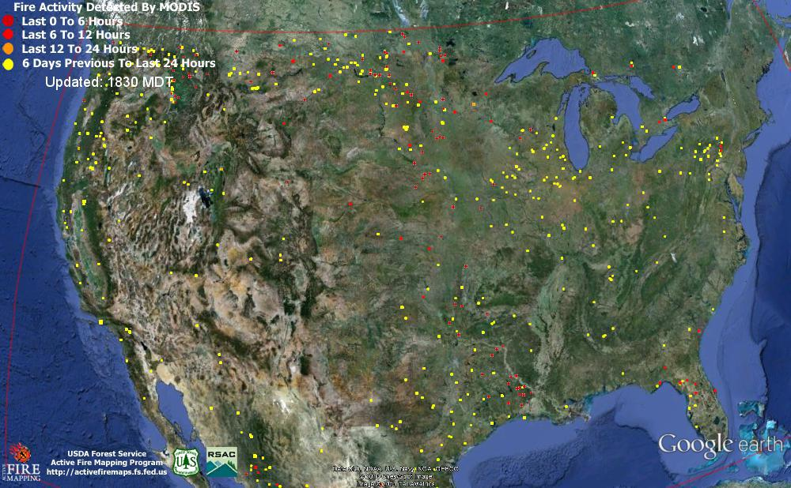


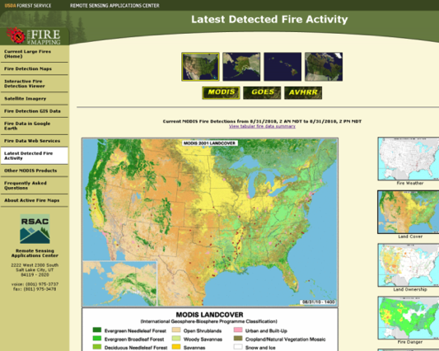
Active Fire Mapping (AFM) Program
USFS operational use of NASA MODIS for wildfire activity in CONUS, Alaska, Hawaii & Canada
Facilitates decision support for strategic planning & response for U.S.
and Canadian fire agencies

Slide 16
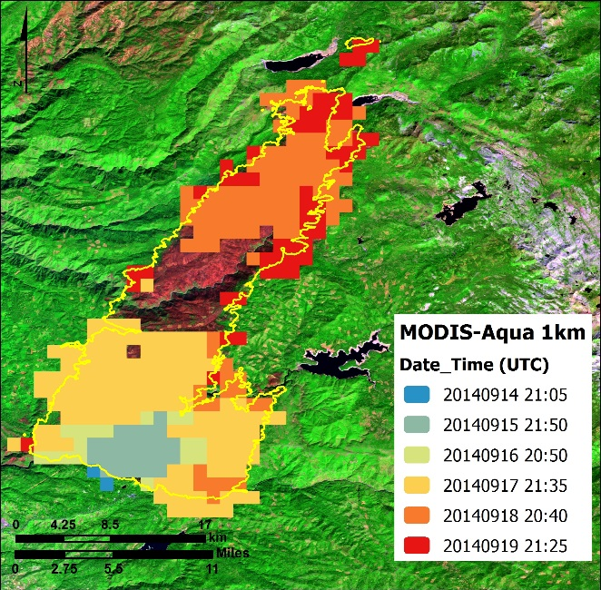
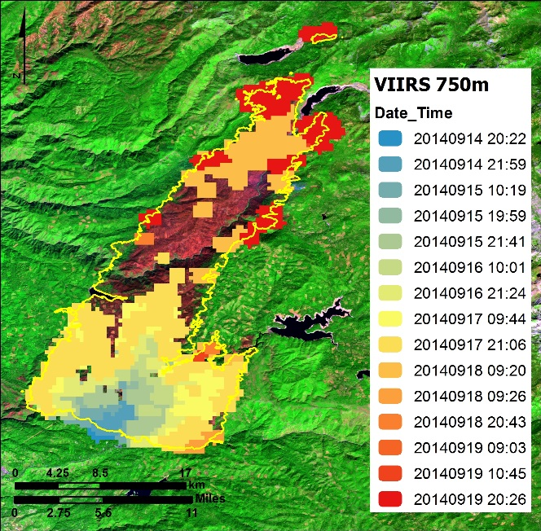
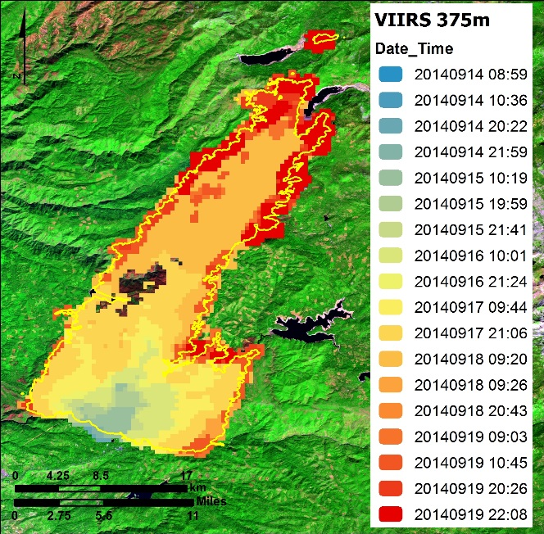
VIIRS – The Next Generation of Fire Support
The new VIIRS 375 m active fire detection product enables early detection of small fires and improved mapping of large wildfires.
Aqua MODIS 1 km
Suomi-NPP VIIRS 750m
VIIRS 375 m
Wildfire progression: Comparing MODIS & VIIRS 750 & 375m products: Schroeder et al.
“These refined data further improve the situational awareness of fire managers and are also ingested into operational modeling, analysis and visualization applications that support fire management decision-making at a landscape scale.” –Brad Quayle, F.S.
VIIRS new fire algorithm complements temporally & spatially limited airborne & spaceborne (e.g., NIROPS, Landsat-8 & upcoming Sentinel-2) data to identify remote lightning strikes, support tactical firefighting, evacuation & strategic planning to mitigate ecological & flood impact.
Notes:
NIROPS - National Infrared Operations for the USDA Forest Service
RSAC – Remote Sensing Applications Center
New VIIRS algorithm just released on USDA Forest Service RSAC website
VIIRS fire detection provides a greatly improved level of detail.
The new 375m science (IDL code) algorithm is running in a semi-operational state at RSAC and AFIS (South Africa) using direct broadcast data.
These data are being used to complement other spatially refined airborne (e.g., NIROPS, FireMapper) and spaceborne (e.g., Landsat-8 and upcoming Sentinel-2) fire data sets of more limited geographic and/or temporal coverage
Also, algorithms are in place to process AMS airborne sensor data (now under the responsibility of the Forest Service).
Additionally, in the past few days FS Brad Quayle notified PI Schroeder that the Landsat-8 active fire detection algorithm he developed is being used to process a large number of scenes for the US, creating a more robust data base for that sensor data. The plan is to process all scenes available for the US (possibly global – Wilfrid’s choice). This will serve multiple purposes such as historical fire analyses, seeding of other algorithms (e.g., burned area mapping, fire and weather modeling/mapping), and fire management (provided data latency reduced further - currently L1 data are available within ~4h).
Three wildfire progression images are of the King fire in El Dorado National Forest east of Sacramento, California. Each image shows the same fire over roughly the same time period as it progressed in September 2014 from lower left to upper right across the image.
International
Algorithms implemented at Merak Institute in South Africa and are providing near-real-time data.
Fire managers in Kruger National Park in South Africa and other international delegates were trained on the VIIRS algorithms as part of a multinational validation campaign in late August 2014, and they continue to use the images to manage Kruger fires, even as the validation campaign wound down.
Coincidentally, Kruger experienced large wildfires; managers are using VIIRS 375 m to track fire progression.
International Field Campaign, late August 2014
UMD fire team (with some NASA and NOAA funding –one government cooperation) helped coordinate a field campaign to validate VIIRS, MODIS, and TET-1 (German satellite) during the second half of August in Kruger National Park, South Africa.
The experiment went really well and included a training workshop where delegates from the Southern African region were exposed to the new satellite products and hands-on field measurements as a form of capacity building.
Fire scientists from the U.S., U.K., Germany, and Brazil were leading the science component, all contributing their own funding (mostly travel) to collaborate in this exercise.
The START program helped cover the costs for all regional delegates and logistics (accommodation, cars, helicopter, etc.).
Quotes
“We have had some serious wildfires over the last week and VIIRS 375m data has performed excellently!”
Philip Frost; Research Group Leader; CSIR-Meraka Institute
“ http://www.news24.com/Green/News/Fire-rages-in-Kruger-National-Park-20140918
Wilfred's 375m VIIRS product shows the fires of yesterday in great detail, see: http://southernafrica.afis.co.za/”
Riaan van den Dool, Senior Engineer
Earth Observation Science and IT (EOSIT)
Meraka Institute, CSIR, Pretoria, South Africa
“Your presentation received many mentions in the evaluation from both sessions and the Fire Behavior Analyst group was very impressed and
interested in the work…”
Ben Newburn, Fire Management Specialist, Vegetation Management Solutions
USDA Forest Service

Slide 17
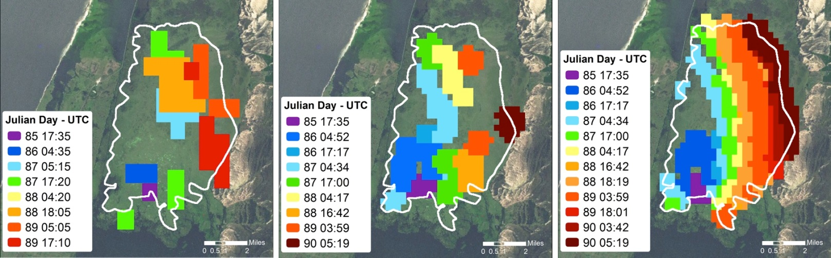
VIIRS Supports Multi-National Fire Operations
The new VIIRS 375 m active fire detection product enables early detection of small fires and improved mapping of large wildfires.
Aqua MODIS 1 km
Suomi-NPP VIIRS 750m
VIIRS 375 m
Wildfire progression: Comparing MODIS & VIIRS 750 & 375m products: Schroeder et al.
NASA, NOAA, Germany, Brazil, U.K. and START validation campaign in South Africa’s Kruger National Park included local fire managers;
Capacity building training held for South African delegates; and
South Africans continue to use the data to manage wildfires in Kruger.
New algorithm currently used by U.S. Forest Service and South Africa;
Algorithm requests from Germany, Scotland, Argentina, Brazil and more.
South Africa’s CSIR – Meraka’s Phillip Frost commented on the “serious wildfire” and “VIIRS 375m data has performed excellently!”
Notes:
The slide depicts VIIRS fire products in use around the world.
Three wildfire progression images are of a fire in the Taim Ecological Reserve, Brazil. Each image shows the same fire over roughly the same time period as it progressed from left to right across the image.
Fire managers in Kruger National Park in South Africa and other international delegates were trained on the VIIRS algorithms as part of a multinational validation campaign in late August 2014, and they continue to use the images to manage Kruger fires, even as the validation campaign wound down.
New VIIRS algorithm just released on USDA Forest Service RSAC website
VIIRS fire detection provides a greatly improved level of detail.
The new 375m science (IDL code) algorithm is running in a semi-operational state at RSAC and AFIS (South Africa) using direct broadcast data.
International
Algorithms implemented at Merak Institute in South Africa and are providing near-real-time data
Coincidentally, Kruger experienced large wildfires; managers are using VIIRS 375 m to track fire progression.
International Field Campaign, late August 2014
UMD fire team (with some NASA and NOAA funding –one government cooperation) helped coordinate a field campaign to validate VIIRS, MODIS, and TET-1 (German satellite) during the second half of August in Kruger National Park, South Africa.
The experiment went very well and included a training workshop where delegates from the Southern African region were exposed to the new satellite products and hands-on field measurements as a form of capacity building.
Fire scientists from the U.S., U.K., Germany, and Brazil were leading the science component, all contributing their own funding (mostly travel) to collaborate in this exercise.
The START program helped cover the costs for all regional delegates and logistics (accommodation, cars, helicopter, etc.).
United States Forest Service
NIROPS - National Infrared Operations for the USDA Forest Service
RSAC – Remote Sensing Applications Center
These data are being used to complement other spatially refined airborne (e.g., NIROPS, FireMapper) and spaceborne (e.g., Landsat-8 and upcoming Sentinel-2) fire data sets of more limited geographic and/or temporal coverage
Also have algorithms in place to process AMS airborne sensor data (now under the responsibility of the Forest Service).
Additionally, in the past few days FS Brad Quayle notified PI Schroeder that the Landsat-8 active fire detection algorithm he developed is being used to process a large number of scenes for the US, creating a more robust data base for that sensor data. The plan is to process all scenes available for the US (possibly global – Wilfrid’s choice). This will serve multiple purposes such as historical fire analyses, seeding of other algorithms (e.g., burned area mapping, fire and weather modeling/mapping), and fire management (provided data latency reduced further - currently L1 data are available within ~4h).
Quotes
“We have had some serious wildfires over the last week and VIIRS 375m data has performed excellently!”
Philip Frost; Research Group Leader; CSIR-Meraka Institute
“ http://www.news24.com/Green/News/Fire-rages-in-Kruger-National-Park-20140918
Wilfred's 375m VIIRS product shows the fires of yesterday in great detail, see: http://southernafrica.afis.co.za/”
Riaan van den Dool, Senior Engineer
Earth Observation Science and IT (EOSIT)
Meraka Institute, CSIR, Pretoria, South Africa
“Your presentation received many mentions in the evaluation from both sessions and the Fire Behavior Analyst group was very impressed and
interested in the work…”
Ben Newburn, Fire Management Specialist, Vegetation Management Solutions
USDA Forest Service

Slide 18
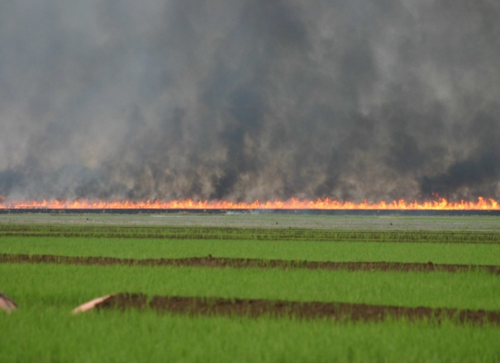
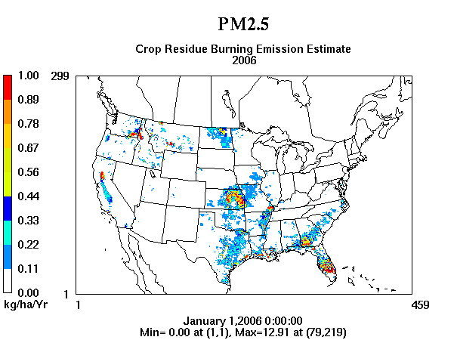
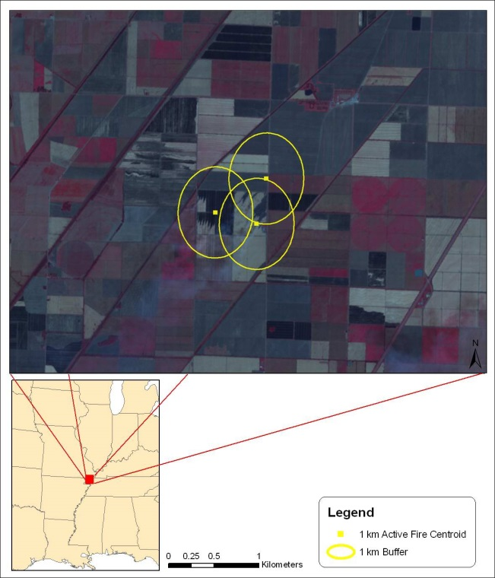
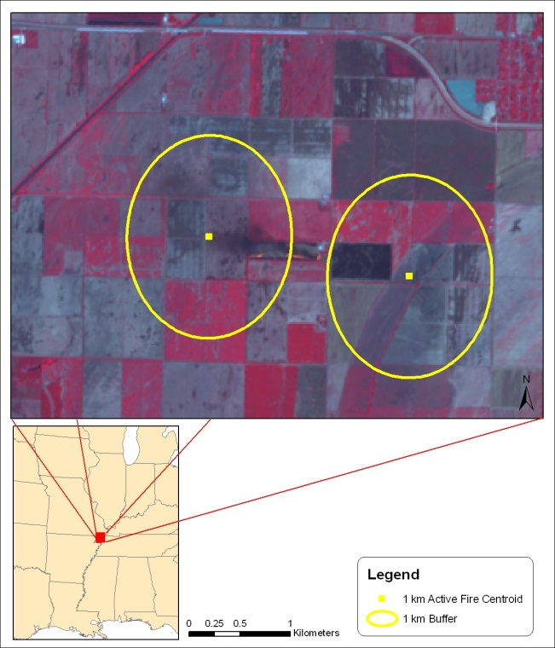
Informing U.S. National Emissions Inventories:
Rule and Regulatory setting ultimately for improving human health
Jessica L. McCarty, PhD
Quantifying Cropland Burning and Related Emissions Using NASA Sensors
McCarty refined MODIS based cropland burned algorithm to produce county, state, and lat/long specific emission estimates for contiguous U.S. (CONUS) for 25 atmospheric species and 21 crop types (Figure 1).
Include as the official source of cropland burning emissions for 2011EPA’s National Emissions Inventory.
Provided detailed uncertainty analyses upon request from state environmental agencies.
  NASA Applications contract # NNX12AQ90G; PI: Soja.
Cropland burning affects local and regional air quality, is a consistent source of emissions, and, as source of GHG /short-lived climate forcers, its impact on climate is not well understood (photo by J. McCarty).
Figure 2. CMAQ modeling of annual cropland burning emissions for 2006.
Figure 1. PM2.5 emissions for cropland burning in the CONUS by crop type.

Slide 19

Questions ?
Earth Science Serving Society:
NASA Earth Science Applications Program - Wildland Fire
Amber Soja and Vince Ambrosia
Associate Program Managers
NASA Applied Science Program
Wildland Fire
Lawrence Friedl
Program Manager
amber.j.soja@nasa.gov
vincent.g.ambrosia@nasa.gov
Science Directorate
Earth Science
Applications Science
Wildland Fire
Notes:
Geospatial World Forum 2013: Monetizing Geospatial Value and Practices
Seminar on Societal Impacts and Benefits of Improved Environmental and Geospatial Information.
Paper Title
Benefits of NASA Earth Science and Earth-observing Satellites
Speaker
Lawrence Friedl
Director, Applied Sciences Program
Earth Science Division
NASA Headquarters
Washington, DC 20546 USA
This talk will focus on efforts to substantiate socioeconomic benefits associated with the use of NASA’s Earth-observing satellite observations in policy and management decisions. The talk will provide a brief overview of NASA’s Applied Sciences Program. The talk will present case studies on socioeconomic impact analyses of applications in several areas, including aviation safety, public health, and fisheries. Finally, the talk will discuss activities to pursue a research agenda on analytic techniques, develop a body of knowledge, and promote broader skills and capabilities.

Slide 20
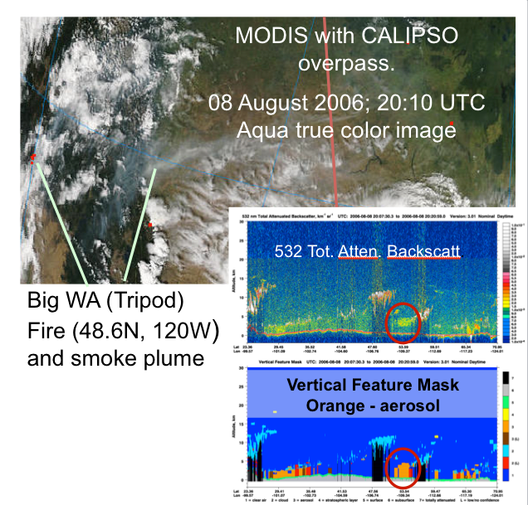
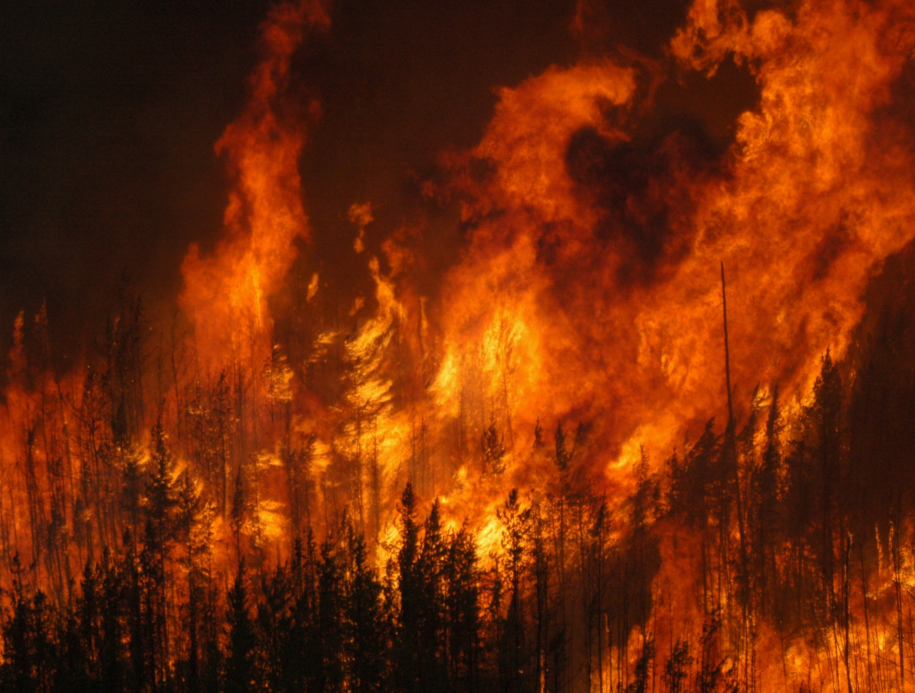
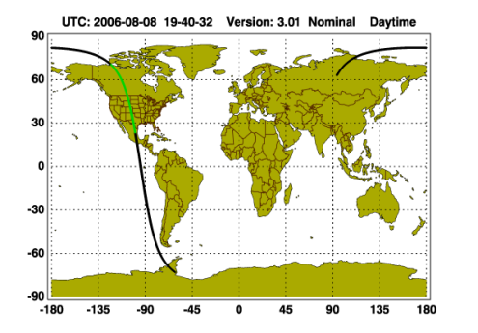
Application of CALIOP data to define smoke plume evolution and
establish plume injection height and fire weather statistics under a
NASA Air Quality project
w/ LaRC trajectory model & MODIS.
Smoke attributable
to fire.
Plume statistics previously unavailable, MISR (morning only) and CALIOP currently available.
CALIPSO provides a random view of complicated 3-D temporal and spatial fire plume data, one that represents a range of fire types from agricultural to large wildfires and is not limited by a particular time of day.

Slide 21
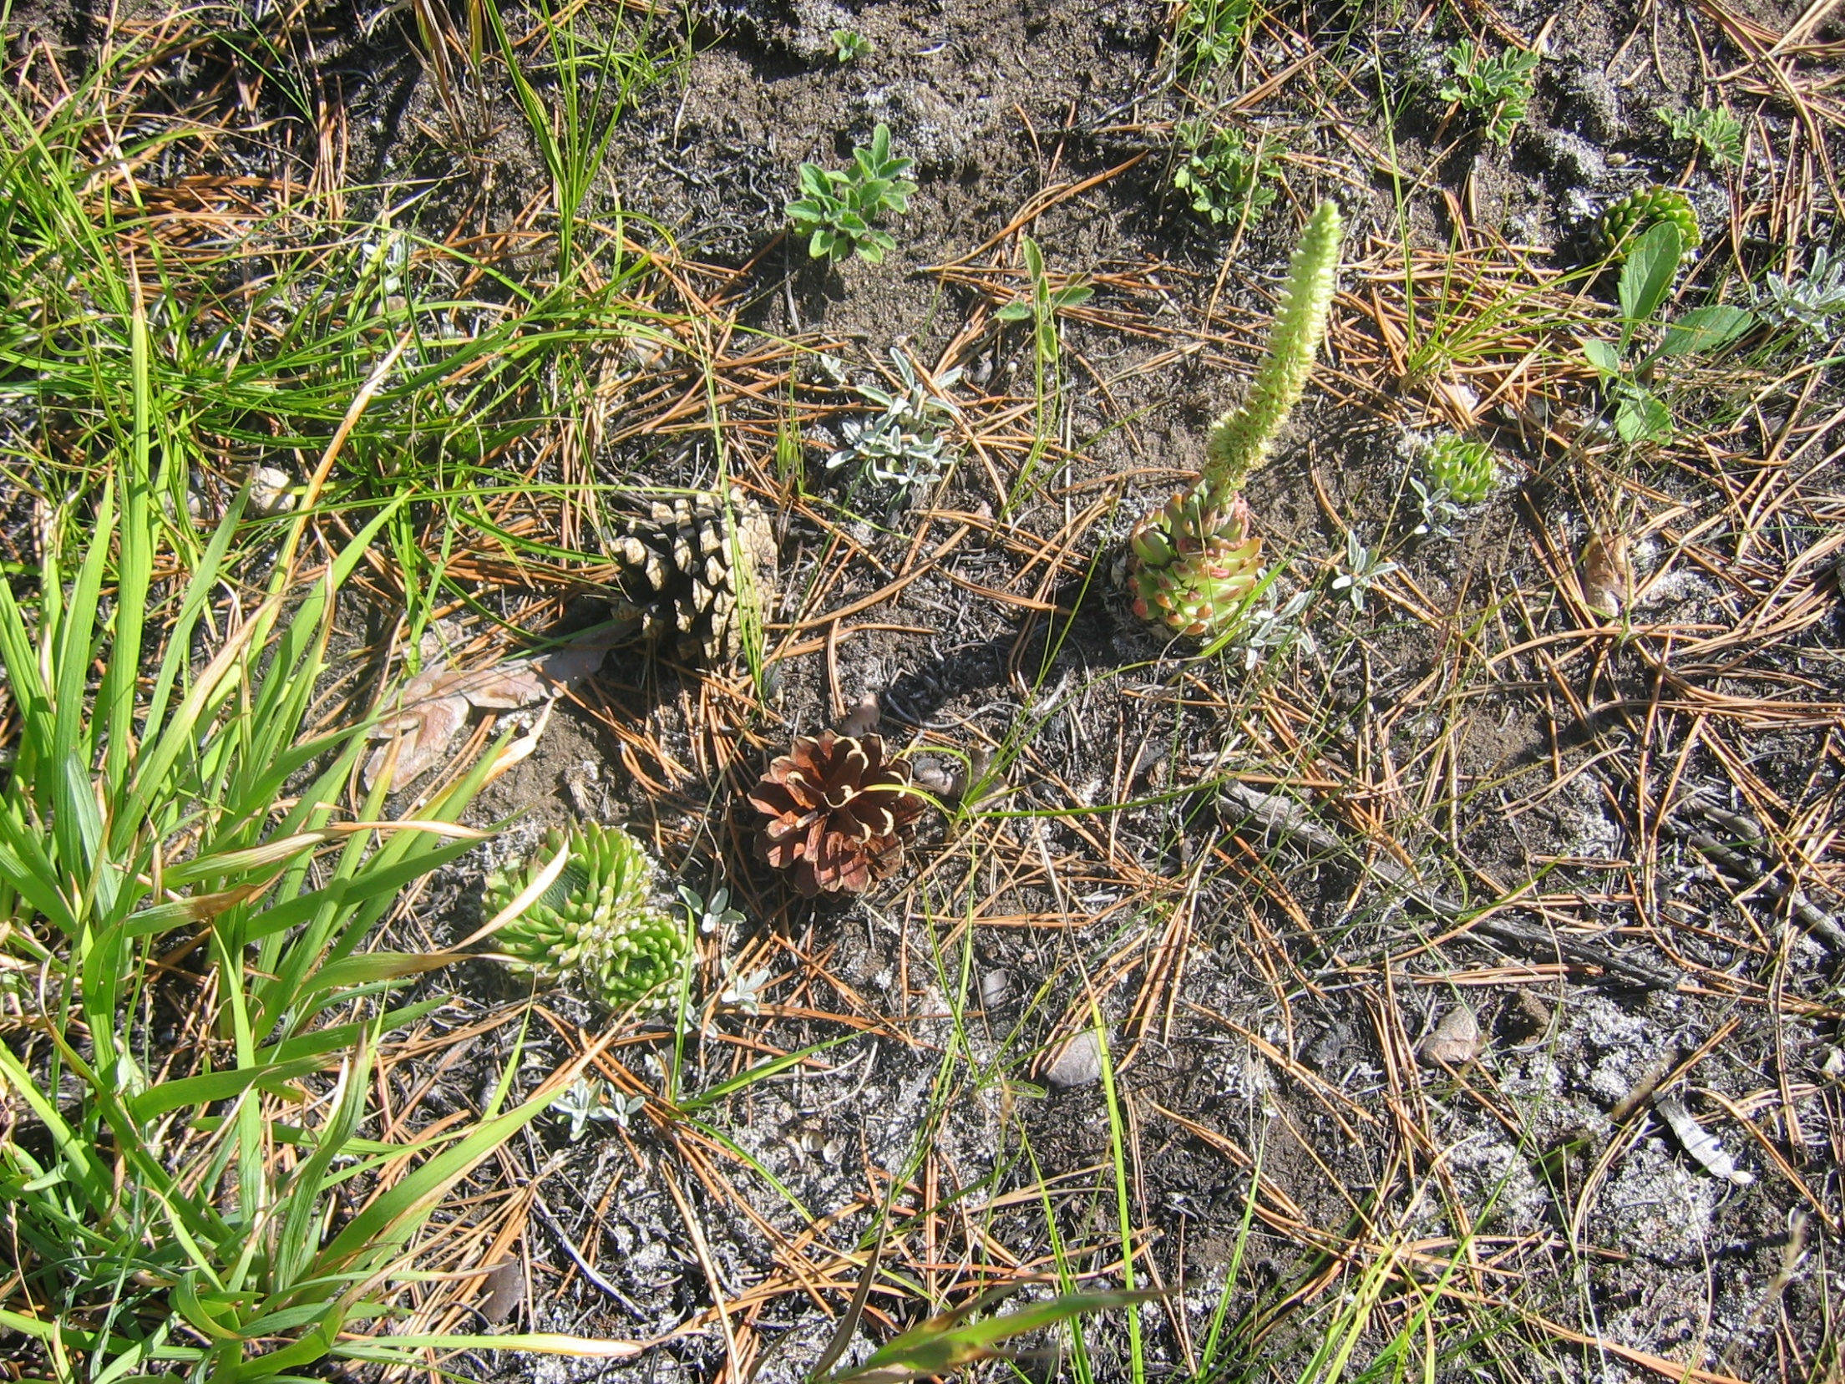
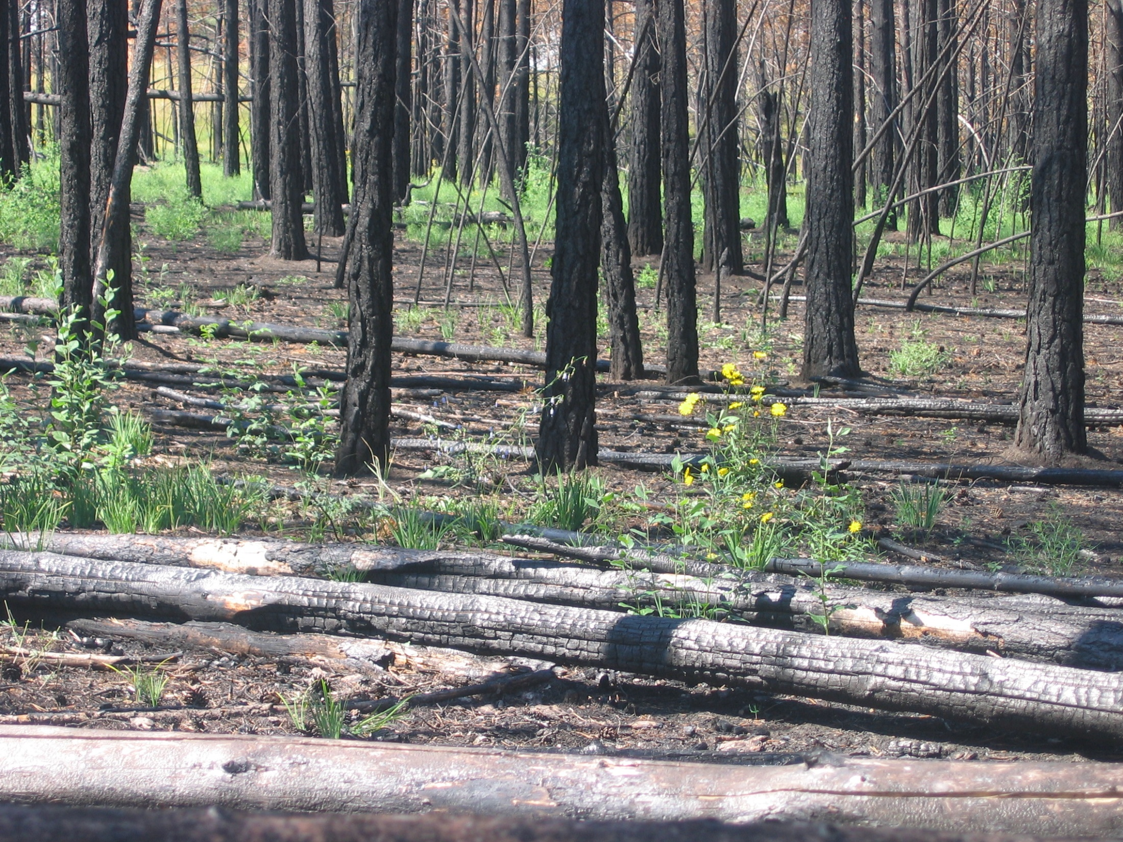



IDS: Tyva, Siberia: Locals report forests are disappearing; Models predict this area should exhibit the initial signs of climate change; Field research results - severity of fire increasing & saplings growing conditions hotter and dryer.
Satellites show no change in forest fire frequency or burned area.
Siberian
cat
Krasnoyarsk
Steppe
Forest
SiBCliM
Results
Abakan
Tchebakova,
Parfenova,
et al. 2006
Kyzyl
This is a Forest Steppe ecosystem already on the margin.

Slide 22







Rim Fire, California, August / September 2013
Visible Infrared Imaging Radiometer Suite (VIIRS; Suomi NPP of Rim Fire (August 23 - August 26)
Rim Fire burned for over two months (8/17 to ~ 11/1);
257,314 acres (104131 hectares);
3rd largest fire in CA history;
Peak # of firefighters: 5,100
Impacts seen across continent!
Aug. 25, 2013 MODIS natural color image with TIR fire detects
Aug. 26, 2013 CO Plume; Atmospheric Infrared Sounder (AIRS)
Rim Fire MODIS TIR fire detects and burned area perimeter

Slide 23
Wildfires Solicitation: ROSES A.35
Purpose of Solicitation
The objective of this solicitation was to select applications and applied research projects to improve decision-making activities and actions on topics related to wildland fires, such as wildfires, rangeland fires, and prescribed fires.
Successful projects must advance organizations’ use and application of Earth observations in analysis and assessments, management strategies and actions, business practices, and policy analysis and decisions associated with wildland fires.
The applied community adds substantial value to NASA data, science, products and models and we have considerable to offer.
|‌ 23

